Slide 1

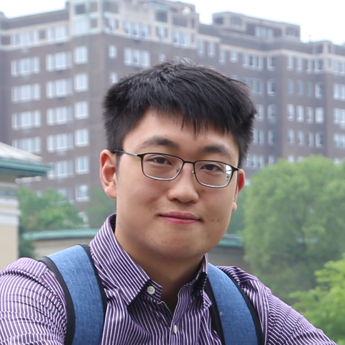

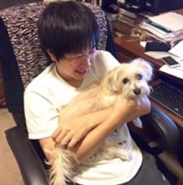
Memory Bounds for the Experts Problem
Vaidehi Srinivas
David P. Woodruff
Ziyu (Neil) Xu
Samson Zhou

Slide 2






Prediction with Expert Advice
a fundamental problem of sequential prediction
Day
You
Actual outcome
1
?
2
?
3
?
4
?

Slide 3
Quantifying Performance
Make no distributional assumptions
We judge our algorithm based on regret.
Definition (Regret)
# of mistakes algorithm makes more than the best expert
# of days

Slide 4
Prediction with Expert Advice
a fundamental problem of sequential prediction
Day
You
Actual outcome
1
?
2
?
3
?
4
?

Slide 5
Prediction with Expert Advice
a fundamental problem of sequential prediction
Day
You
Actual outcome
1
1/4 Regret
2
Algorithm makes 2 mistakes
3
Best expert makes 1 mistake
4

Slide 6
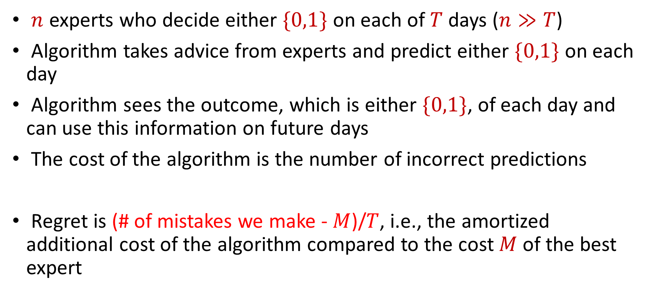
The Online Learning with Experts Problem
$n$ experts who decide either $\{0,1\}$ on each of $T$ days ($n≫T$)
Algorithm takes advice from experts and predict either $\{0,1\}$ on each day
Algorithm sees the outcome, which is either $\{0,1\}$, of each day and can use this information on future days
The cost of the algorithm is the number of incorrect predictions
Regret is (# of mistakes we make - $M$)/$T$, i.e., the amortized additional cost of the algorithm compared to the cost $M$of the best expert

Slide 7
Applications of the Experts Problem
Ensemble learning, e.g., AdaBoost
Forecast and portfolio optimization
Special case of online convex optimization

Slide 8
Weighted Majority (Littlestone, Warmuth 89)
Day
Algorithm
Actual outcome
weights
1
1
1
1
1
1
1/2
1
1
2
1
1/2
1/2
1
3
1/2
1/2
1/4
1/2
4
1/2
1/4
1/4
1/4

Slide 9
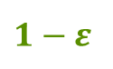
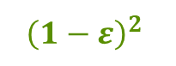
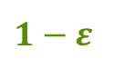

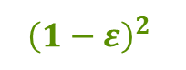
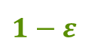
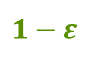
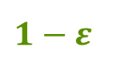
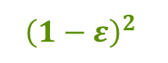


Weighted Majority (Littlestone, Warmuth 89)
Day
Algorithm
Actual outcome
weights
1
1
1
1
1
1
$$1−ε$$
1
1
2
1
$$1−ε$$
$$1−ε$$
1
3
$$1−ε$$
$$1−ε$$
$${\left(1−ε\right)}^{2}$$
$$1−ε$$
4
$$1−ε$$
$${\left(1−ε\right)}^{2}$$
$${\left(1−ε\right)}^{2}$$
$${\left(1−ε\right)}^{2}$$

Slide 10
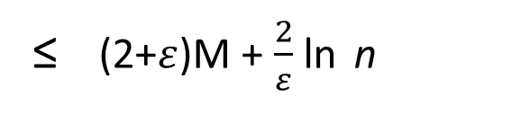
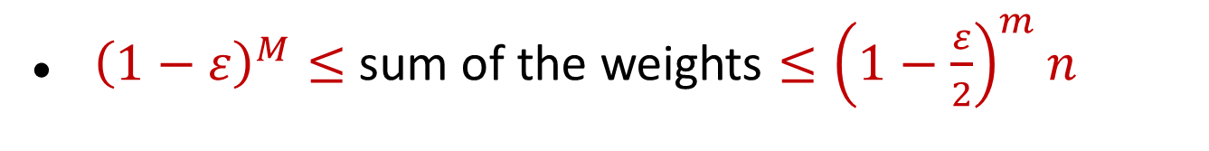
Guarantee for Weighted Majority
Theorem (Deterministic Weighted Majority)
where M is the # of mistakes the best expert makes, n is # of experts.
# of mistakes by deterministic weighted majority
≤ (2+$ε$)M + $\frac{2}{ε}$ ln n
${\left(1−ε\right)}^{M}≤$ sum of the weights $≤{\left(1−\frac{ε}{2}\right)}^{m}n$

Slide 11
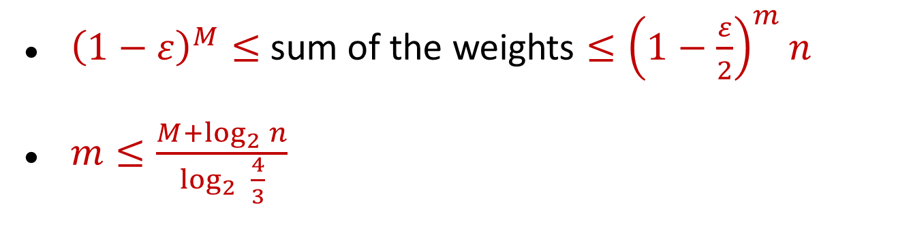
Guarantee for Weighted Majority
Theorem (Deterministic Weighted Majority)
where M is the # of mistakes the best expert makes, n is # of experts.
# of mistakes by deterministic weighted majority
≤ (2+$ε$)M + $\frac{2}{ε}$ ln n
${\left(1−ε\right)}^{M}≤$ sum of the weights $≤{\left(1−\frac{ε}{2}\right)}^{m}n$
$m≤\frac{M+\log_{2}{n}}{\log_{2}{ \frac{4}{3}}}$

Slide 12
Guarantee for Weighted Majority
Theorem (Deterministic Weighted Majority)
where M is the # of mistakes the best expert makes, n is # of experts.
# of mistakes by deterministic weighted majority
≤ (2+$ε$)M + $\frac{2}{ε}$ ln n
Theorem (Randomized Weighted Majority, i.e, Multiplicative Weights)
For ε > 0, can construct algorithm A such that
≤ (1 + ε) M +
O( ln n )
E[# of mistakes by A]
ε

Slide 13
Guarantee for Weighted Majority
Theorem (Deterministic Weighted Majority)
where M is the # of mistakes the best expert makes, n is # of experts.
# of mistakes by deterministic weighted majority
≤ 2.41 (M + log₂ n)
Theorem (Randomized Weighted Majority, i.e, Multiplicative Weights)
For ε > 0, can construct algorithm A such that
≤ (1 + ε) M +
ln n
E[# of mistakes by A]
ε

Slide 14
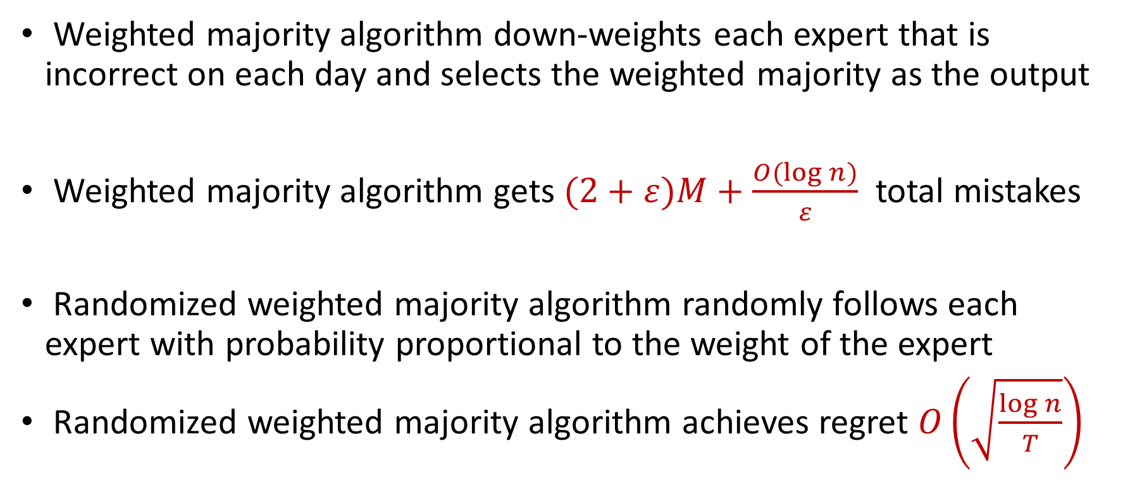
Previous Work
Weighted majority algorithm down-weights each expert that is incorrect on each day and selects the weighted majority as the output
Weighted majority algorithm gets $(2+ε)M+\frac{O(log n)}{ε}$ total mistakes
Randomized weighted majority algorithm randomly follows each expert with probability proportional to the weight of the expert
Randomized weighted majority algorithm achieves regret $O\left(\sqrt{\frac{\log{n}}{T}}\right)$

Slide 15
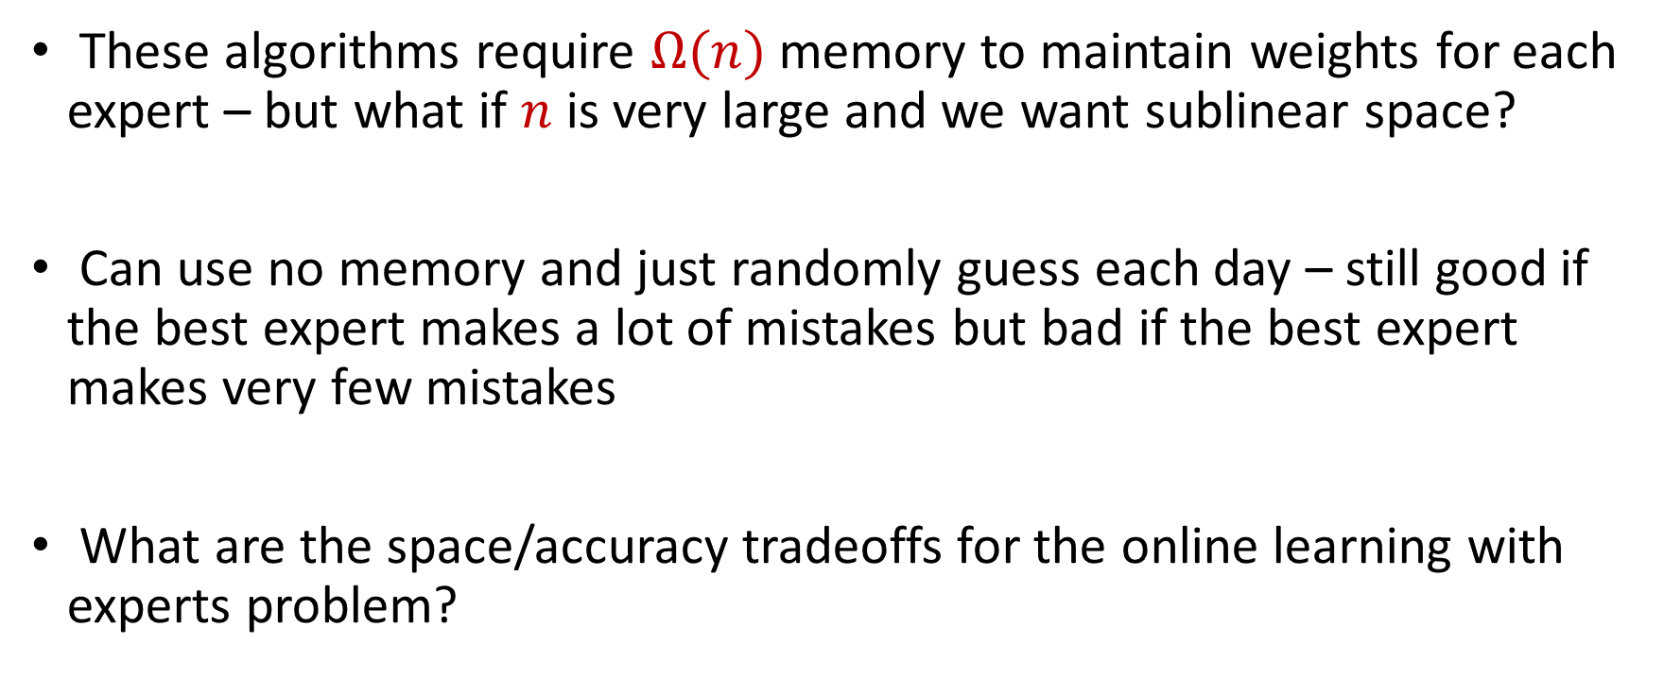
Memory Bounds for the Expert Problem
These algorithms require $Ω(n)$ memory to maintain weights for each expert – but what if $n$ is very large and we want sublinear space?
Can use no memory and just randomly guess each day – still good if the best expert makes a lot of mistakes but bad if the best expert makes very few mistakes
What are the space/accuracy tradeoffs for the online learning with experts problem?

Slide 16
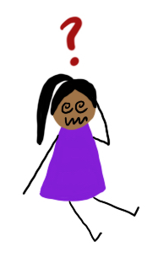
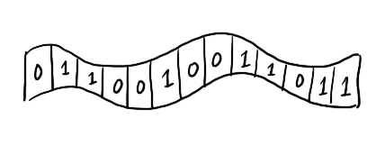


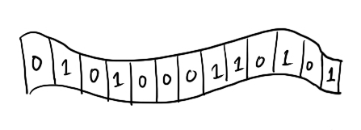
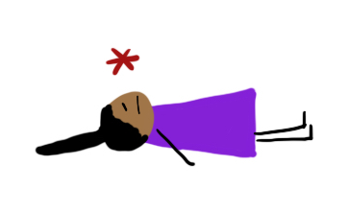
The Streaming Model
wake up with no memory
except a note from your past self
(at most s bits)
see expert predictions for today
make a prediction
see outcome
repeat
write a note to your future self
(at most s bits)
fall asleep and forget everything

Slide 17
The Streaming Model
The complete sequence of T days is the data stream.
(prediction₁, outcome₁), . . . , (prediction_{T}, outcome_{T})
Definition (Arbitrary Order Model)
An adversary chooses a worst-case ordering of the days and outcomes in the stream beforehand.
Definition (Random Order Model)
An adversary chooses worst-case ordering of the outcomes, then the order of days is randomly shuffled.

Slide 18

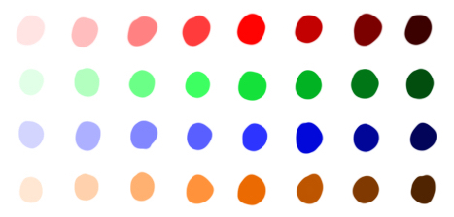







The Streaming Model
The complete sequence of T days is the data stream.
(prediction₁, outcome₁), . . . , (prediction_{T}, outcome_{T})
Definition (Arbitrary Order Model)
An adversary chose the predictions and outcomes to trick you.
days
expert
predictions
Definition (Random Order Model)
An adversary chose the predictions and outcomes to trick you,
then the order was randomly shuffled.

Slide 19
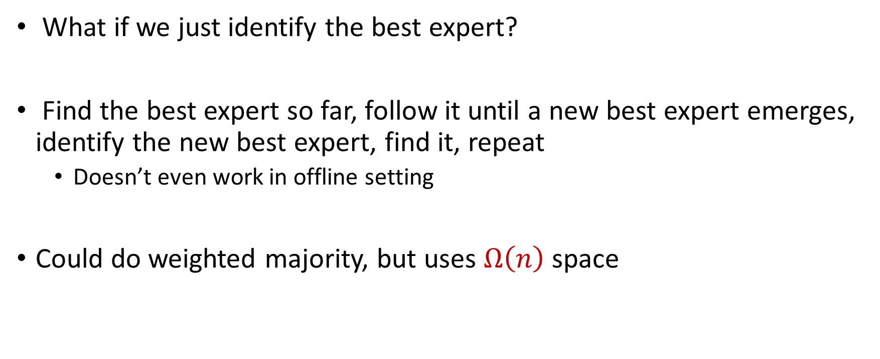
A Natural Idea
What if we just identify the best expert?
Find the best expert so far, follow it until a new best expert emerges, identify the new best expert, find it, repeat
Doesn’t even work in offline setting
Could do weighted majority, but uses $Ω\left(n\right)$ space

Slide 20
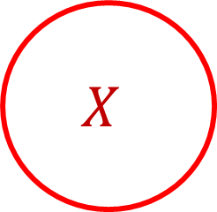
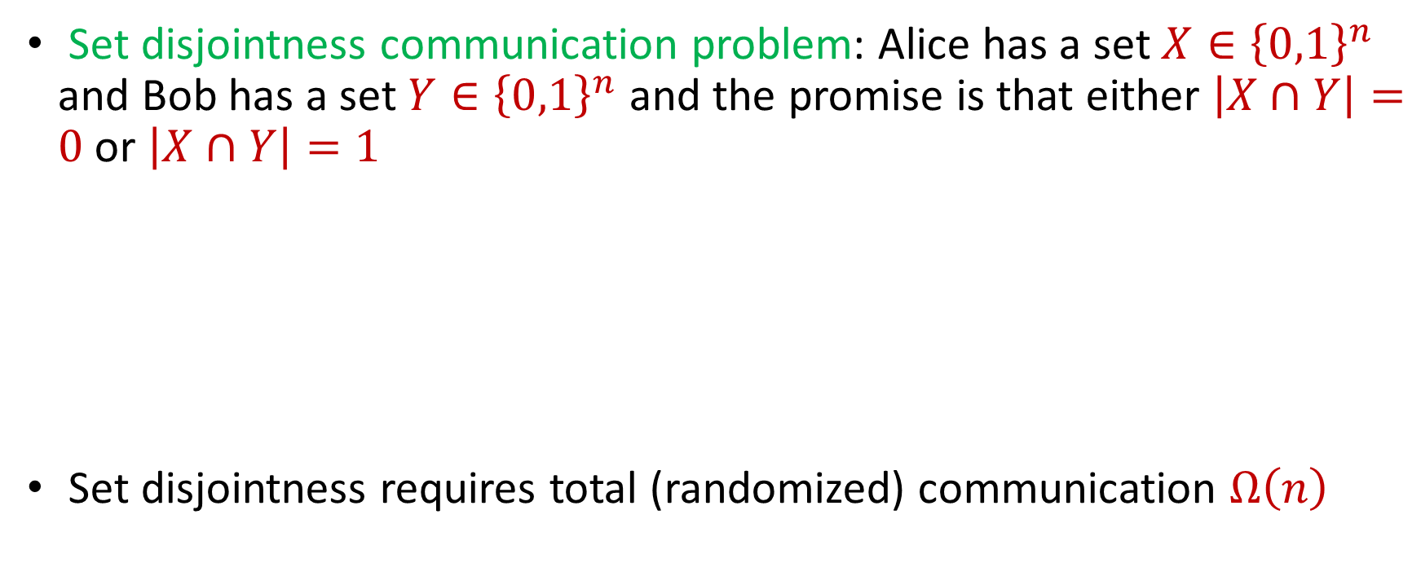
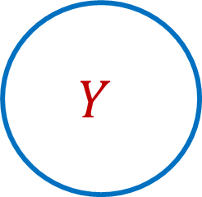
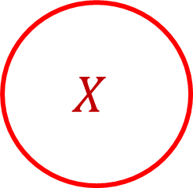

Set Disjointness Communication Problem
Set disjointness communication problem: Alice has a set $X∈{\left\{0,1\right\}}^{n}$ and Bob has a set $Y∈{\left\{0,1\right\}}^{n}$ and the promise is that either $\left|X∩Y\right|=0$ or $\left|X∩Y\right|=1$
Set disjointness requires total (randomized) communication $Ω\left(n\right)$
$$X$$
$$Y$$
$$X$$
$$Y$$

Slide 21
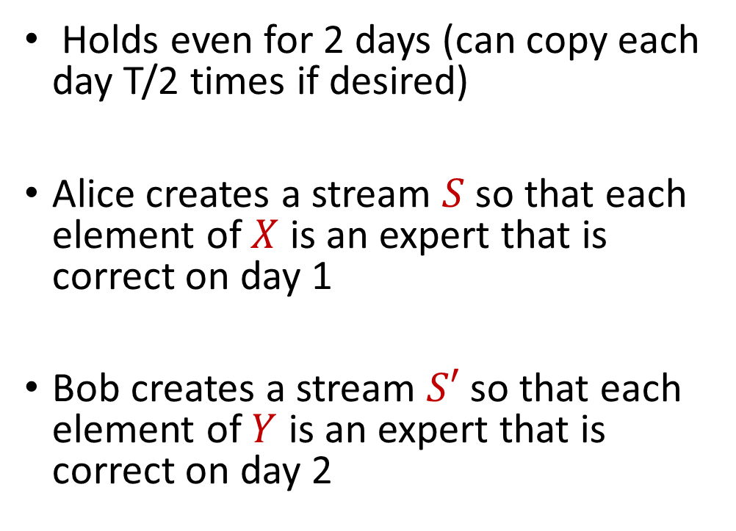
Reduction
Expert 1
Expert 3
Expert 6
Holds even for 2 days (can copy each day T/2 times if desired)
Alice creates a stream $S$so that each element of $X$ is an expert that is correct on day 1
Bob creates a stream $S′$so that each element of $Y$ is an expert that is correct on day 2
Day
Algorithm
1
2

Slide 22
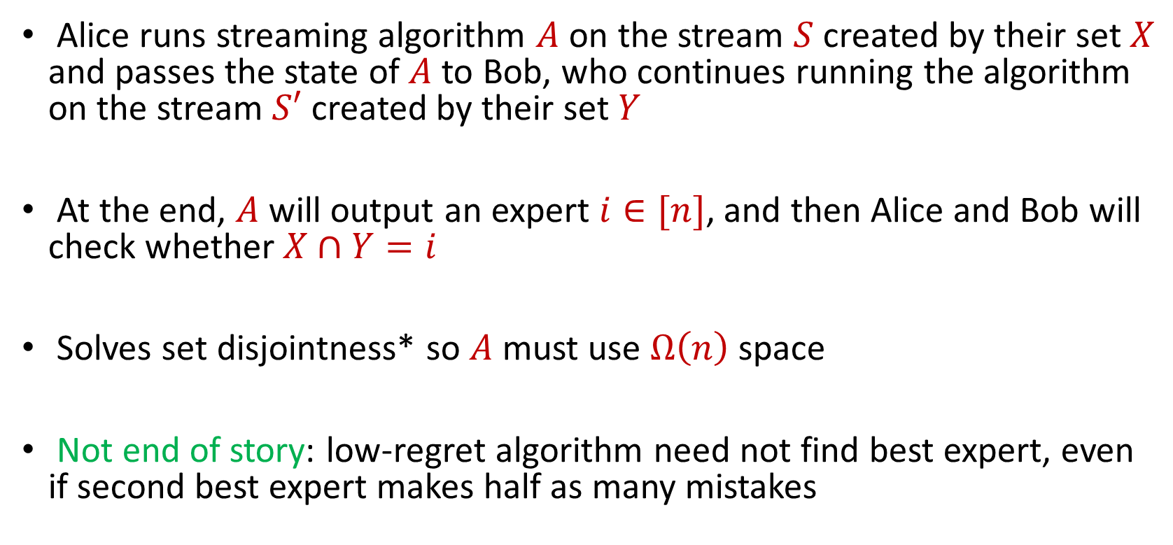
Reduction
Alice runs streaming algorithm $A$ on the stream $S$ created by their set $X$ and passes the state of $A$ to Bob, who continues running the algorithm on the stream $S′$ created by their set $Y$
At the end, $A$ will output an expert $i∈[n]$, and then Alice and Bob will check whether $X∩Y=i$
Solves set disjointness* so $A$ must use $Ω\left(n\right)$ space
Not end of story: low-regret algorithm need not find best expert, even if second best expert makes half as many mistakes

Slide 23

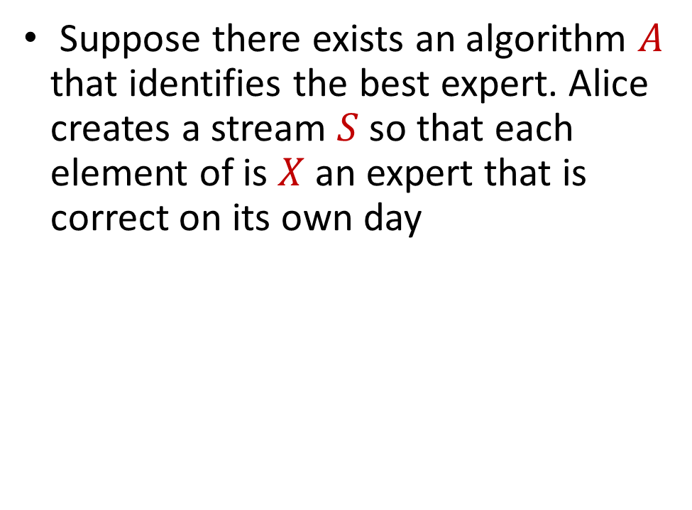
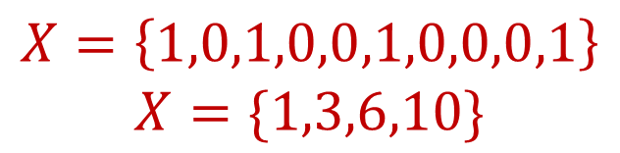
Reduction
Expert 1
Expert 3
Expert 6
Suppose there exists an algorithm $A$ that identifies the best expert. Alice creates a stream $S$so that each element of is $X$ an expert that is correct on its own day
Day
Algorithm
1
$$X$$
2
$$X=\left\{1,0,1,0,0,1,0,0,0,1\right\}$$
$$X=\{1,3,6,10\}$$
3

Slide 24
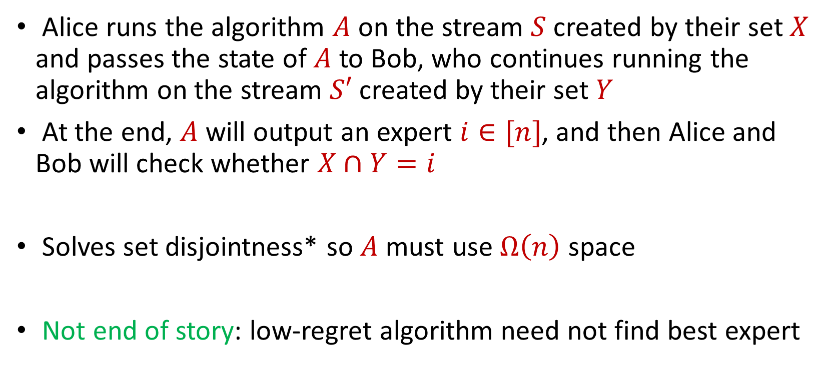
Reduction
Alice runs the algorithm $A$ on the stream $S$ created by their set $X$ and passes the state of $A$ to Bob, who continues running the algorithm on the stream $S′$ created by their set $Y$
At the end, $A$ will output an expert $i∈[n]$, and then Alice and Bob will check whether $X∩Y=i$
Solves set disjointness* so $A$ must use $Ω\left(n\right)$ space
Not end of story: low-regret algorithm need not find best expert

Slide 25
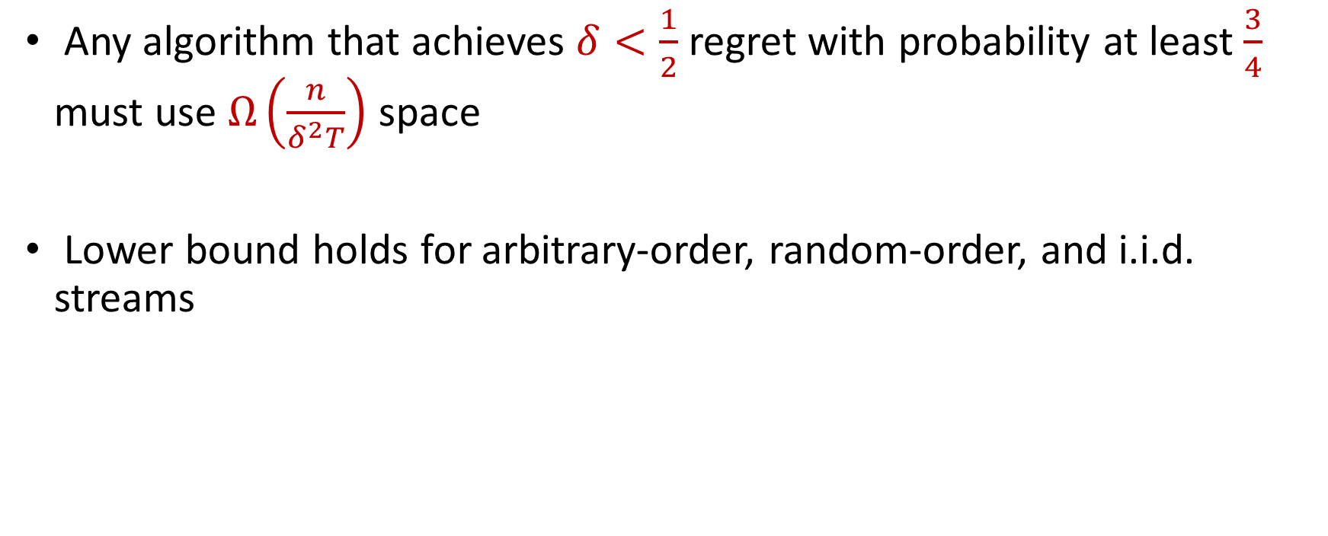
Our Results (I)
Any algorithm that achieves $δ<\frac{1}{2}$ regret with probability at least $\frac{3}{4}$ must use $Ω\left(\frac{n}{δ^{2}T}\right)$ space
Lower bound holds for arbitrary-order, random-order, and i.i.d. streams

Slide 26
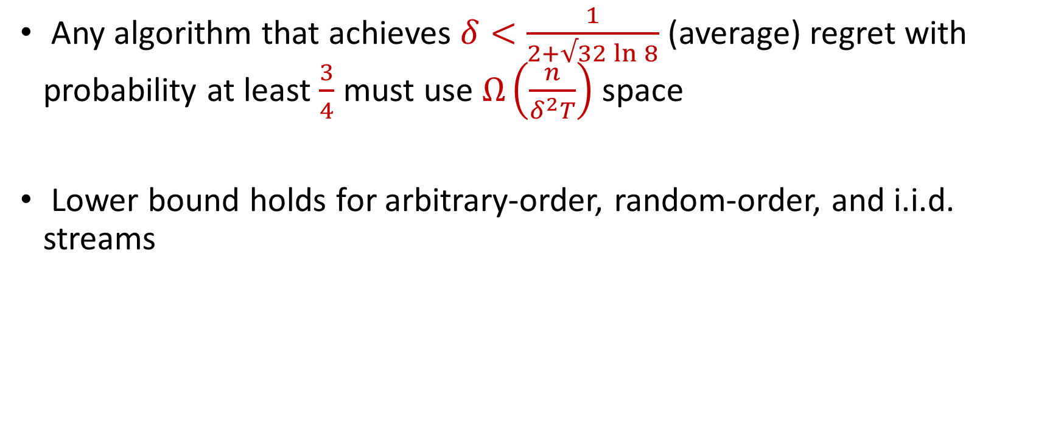
Our Results (I)
Any algorithm that achieves $δ<\frac{1}{2+√32\ln{8}}$ (average) regret with probability at least $\frac{3}{4}$ must use $Ω\left(\frac{n}{δ^{2}T}\right)$ space
Lower bound holds for arbitrary-order, random-order, and i.i.d. streams

Slide 27
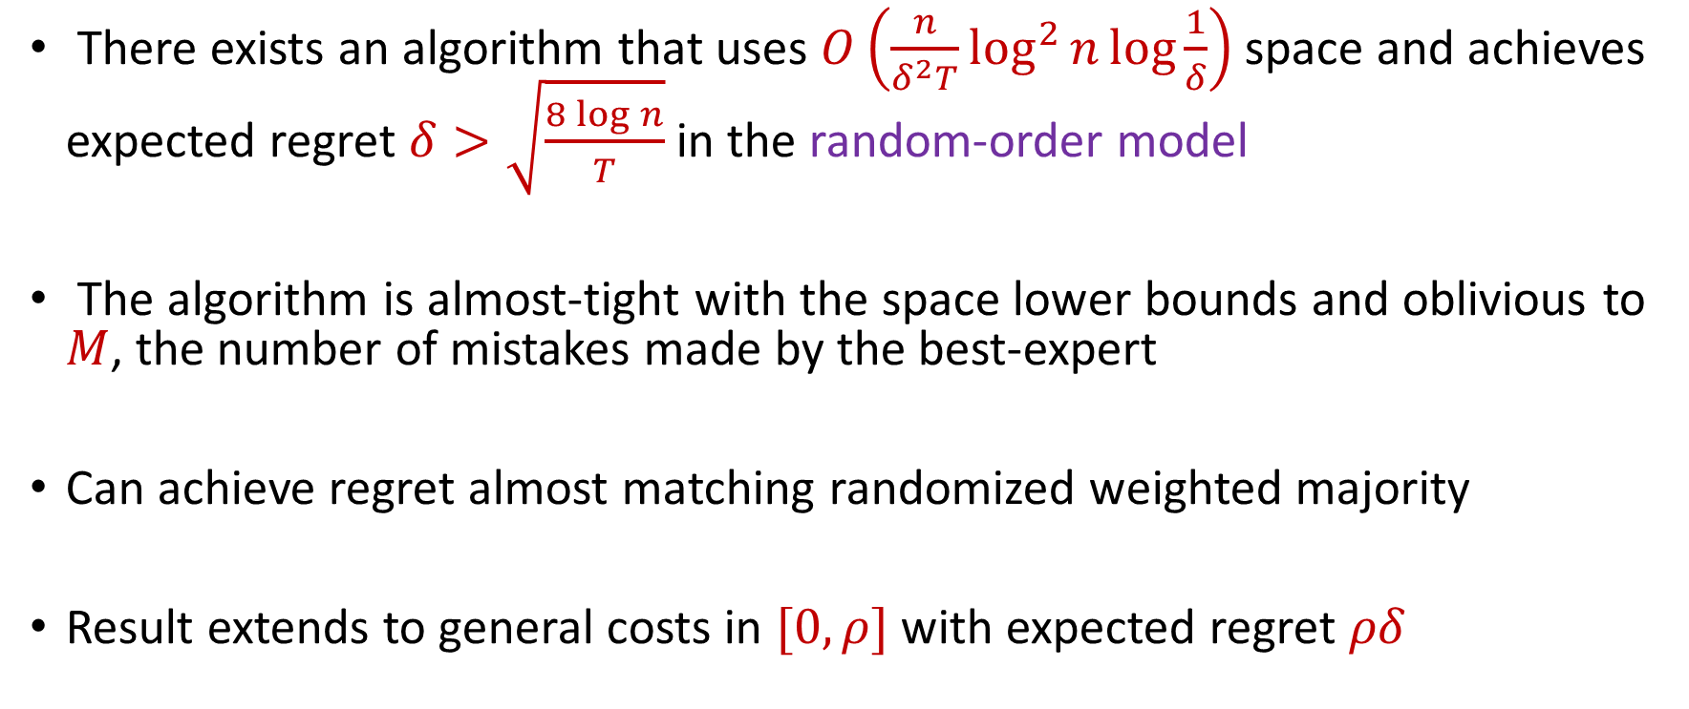
Our Results (II)
There exists an algorithm that uses $O\left(\frac{n}{δ^{2}T}\log^{2}{n}\log{\frac{1}{δ}}\right)$ space and achieves expected regret $δ>\sqrt{\frac{8\log{n}}{T}}$ in the random-order model
The algorithm is almost-tight with the space lower bounds and oblivious to $M$, the number of mistakes made by the best-expert
Can achieve regret almost matching randomized weighted majority
Result extends to general costs in $[0,ρ]$ with expected regret $ρδ$

Slide 28
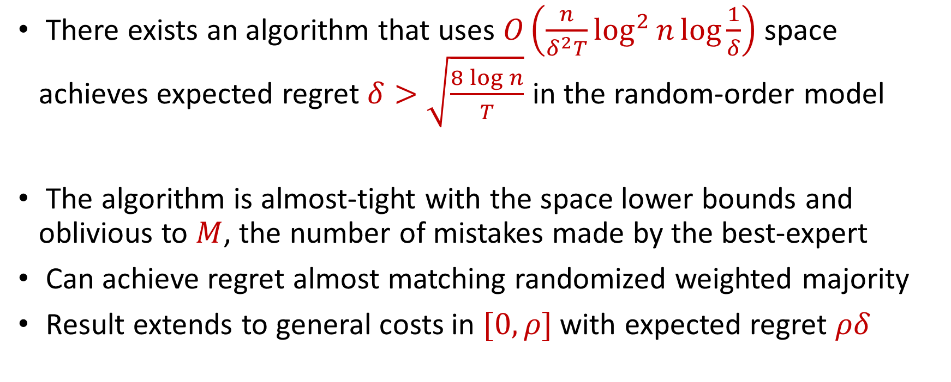
Our Results (II)
There exists an algorithm that uses $O\left(\frac{n}{δ^{2}T}\log^{2}{n}\log{\frac{1}{δ}}\right)$ space achieves expected regret $δ>\sqrt{\frac{8\log{n}}{T}}$ in the random-order model
The algorithm is almost-tight with the space lower bounds and oblivious to $M$, the number of mistakes made by the best-expert
Can achieve regret almost matching randomized weighted majority
Result extends to general costs in $[0,ρ]$ with expected regret $ρδ$

Slide 29
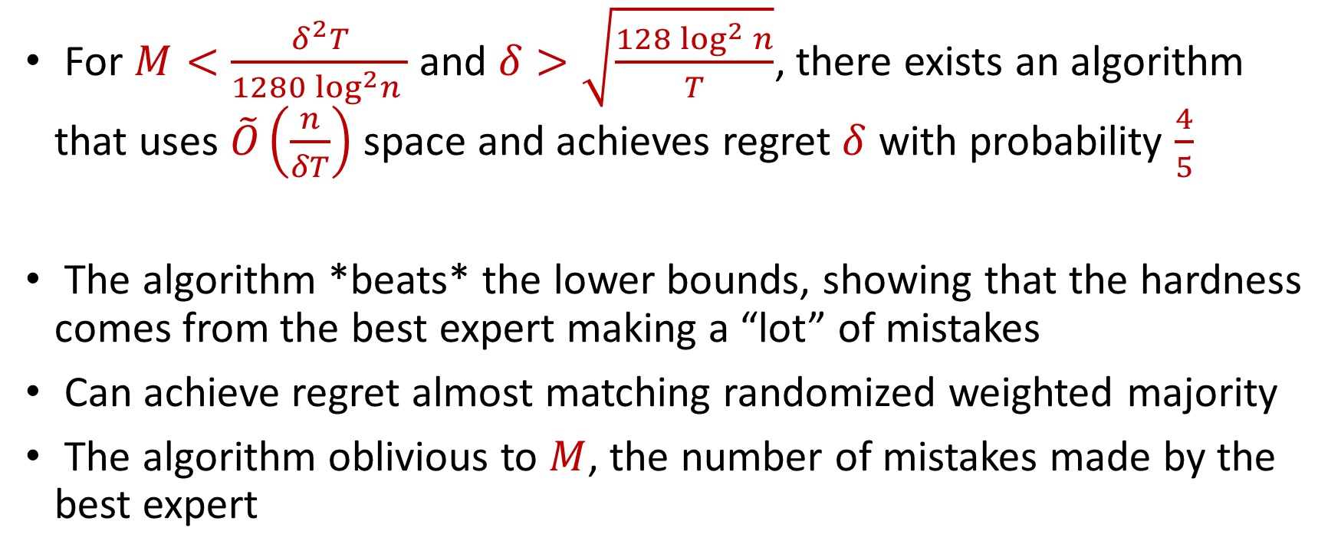
Our Results (III)
For $M<\frac{δ^{2}T}{1280\log^{2}n }$ and $δ>\sqrt{\frac{128\log^{2}{n}}{T}}$, there exists an algorithm that uses $\tilde{O}\left(\frac{n}{δT}\right)$ space and achieves regret $δ$ with probability $\frac{4}{5}$
The algorithm *beats* the lower bounds, showing that the hardness comes from the best expert making a “lot” of mistakes
Can achieve regret almost matching randomized weighted majority
The algorithm oblivious to $M$, the number of mistakes made by the best expert

Slide 30
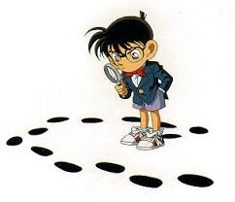
Questions?
Format
Part 1: Background
Part 2: Lower Bound
Part 3: Arbitrary Model
Part 4: Random-Order Model

Slide 31
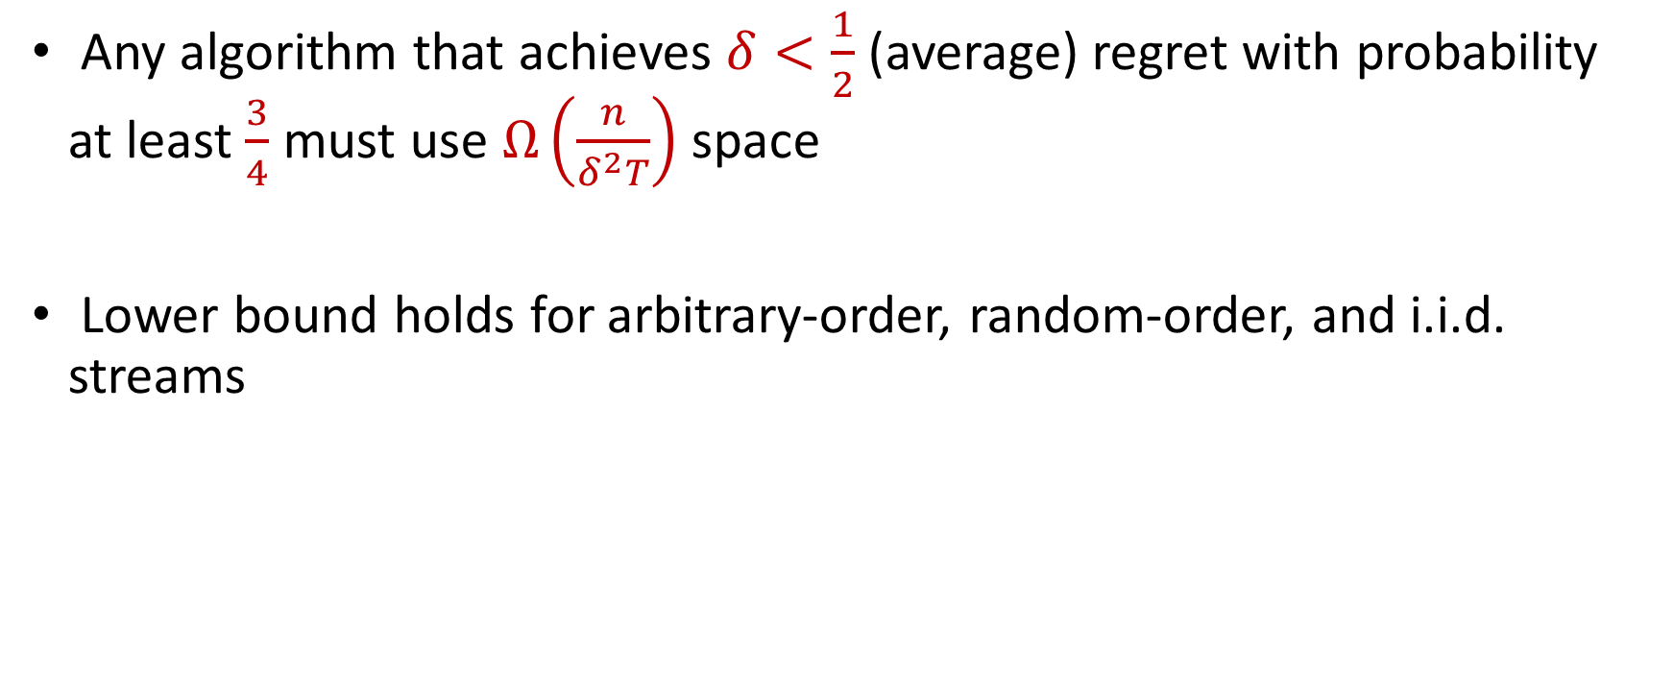
Lower Bound
Any algorithm that achieves $δ<\frac{1}{2}$ (average) regret with probability at least $\frac{3}{4}$ must use $Ω\left(\frac{n}{δ^{2}T}\right)$ space
Lower bound holds for arbitrary-order, random-order, and i.i.d. streams

Slide 32
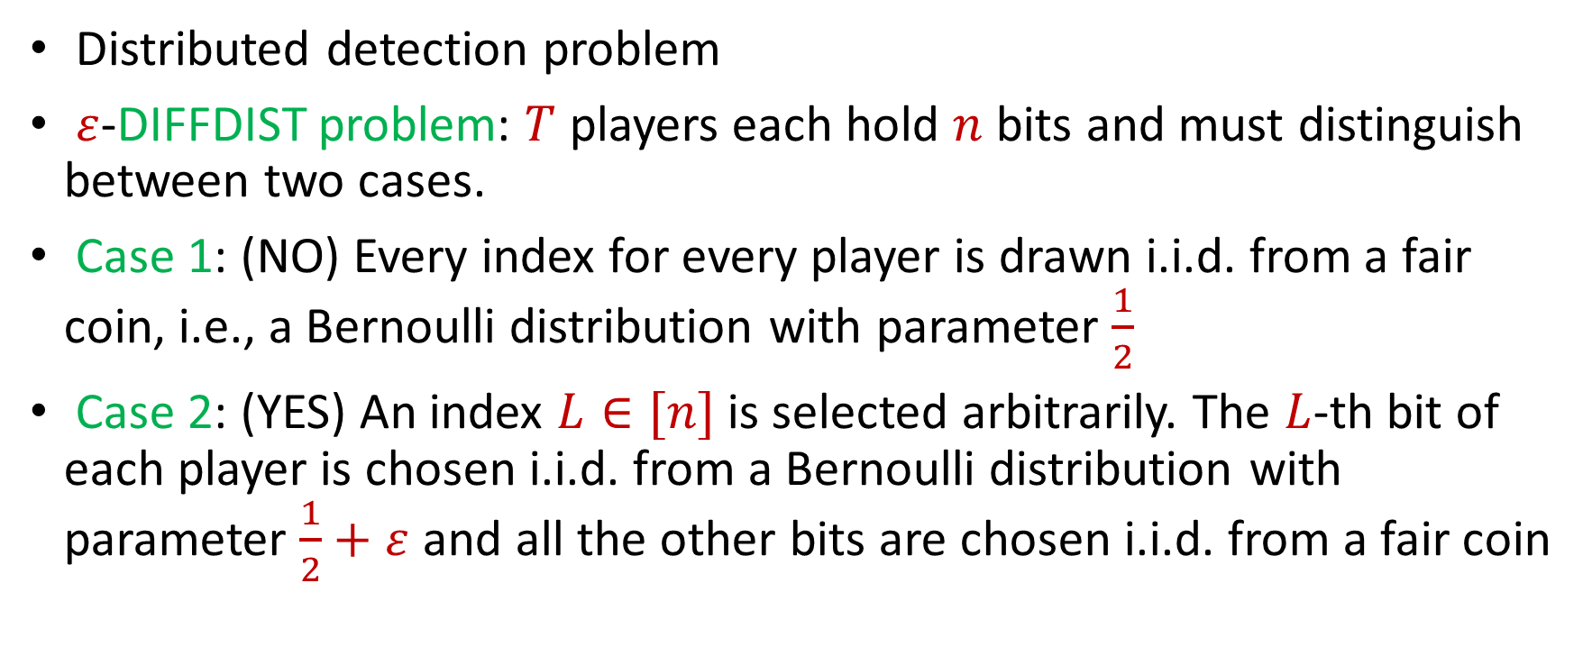
Communication Problem for Lower Bound
Distributed detection problem
$ε$-DIFFDIST problem: $T$ players each hold $n$ bits and must distinguish between two cases.
Case 1: (NO) Every index for every player is drawn i.i.d. from a fair coin, i.e., a Bernoulli distribution with parameter $\frac{1}{2}$
Case 2: (YES) An index $L∈[n]$ is selected arbitrarily. The $L$-th bit of each player is chosen i.i.d. from a Bernoulli distribution with parameter $\frac{1}{2}+ε$ and all the other bits are chosen i.i.d. from a fair coin

Slide 33




Communication Problem for Lower Bound
H
T
H
T
H
H
T
H
T
H
T
H
H
H
H
T
H
H
H
H
NO
YES
H
H
T
H
T
H
H
T
H
T
H
T
H
T
T
H
H
H
T
T

Slide 34
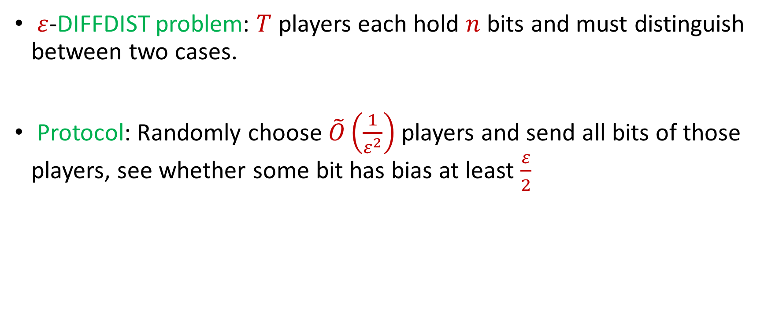
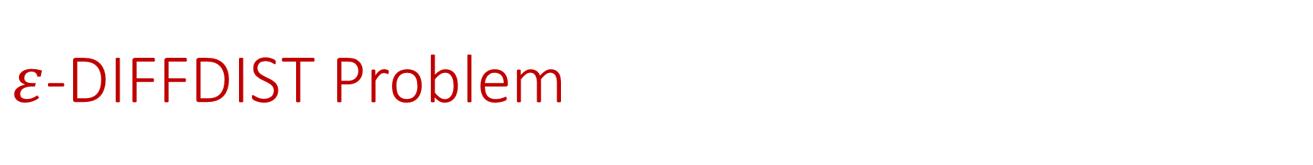
$ε$-DIFFDIST Problem
$ε$-DIFFDIST problem: $T$ players each hold $n$ bits and must distinguish between two cases.
Protocol: Randomly choose $\tilde{O}\left(\frac{1}{ε^{2}}\right)$ players and send all bits of those players, see whether some bit has bias at least $\frac{ε}{2}$

Slide 35
Communication Problem for Lower Bound
H
T
H
T
H
H
T
H
T
H
T
H
H
H
H
T
H
H
H
H
NO
YES
H
H
T
H
T
H
H
T
H
T
H
T
H
T
T
H
H
H
T
T

Slide 36
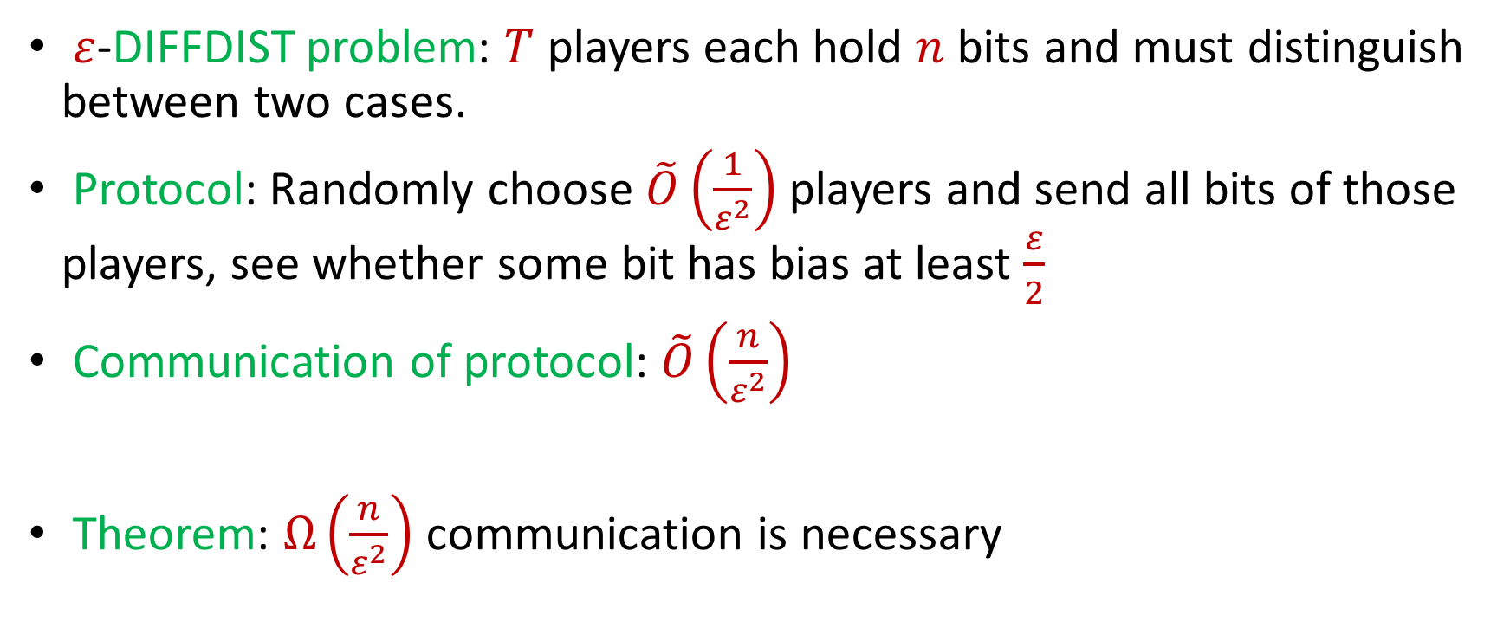
$ε$-DIFFDIST Problem
$ε$-DIFFDIST problem: $T$ players each hold $n$ bits and must distinguish between two cases.
Protocol: Randomly choose $\tilde{O}\left(\frac{1}{ε^{2}}\right)$ players and send all bits of those players, see whether some bit has bias at least $\frac{ε}{2}$
Communication of protocol: $\tilde{O}\left(\frac{n}{ε^{2}}\right)$
Theorem: $Ω\left(\frac{n}{ε^{2}}\right)$ communication is necessary

Slide 37
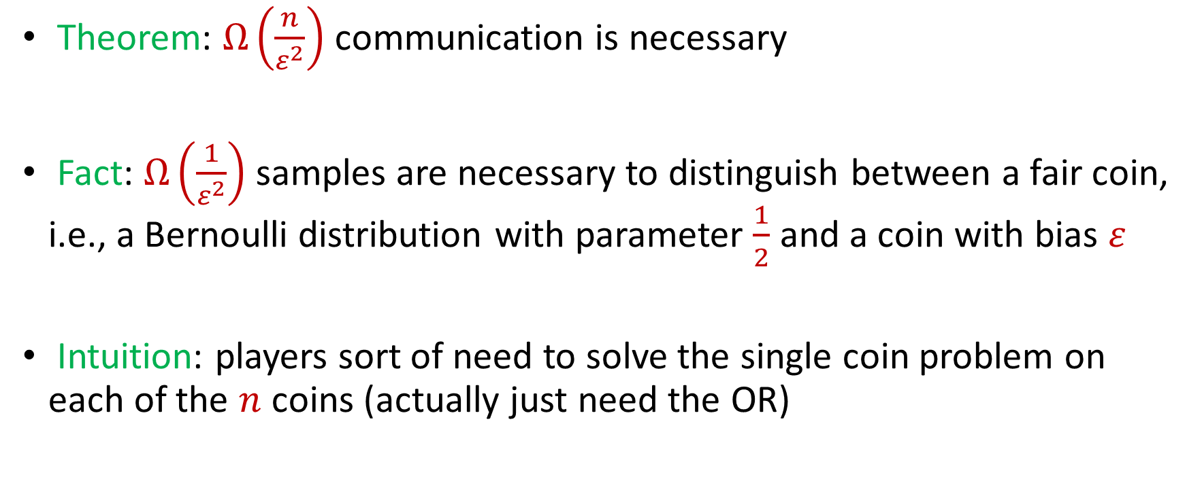
$ε$-DIFFDIST Problem
Theorem: $Ω\left(\frac{n}{ε^{2}}\right)$ communication is necessary
Fact: $Ω\left(\frac{1}{ε^{2}}\right)$ samples are necessary to distinguish between a fair coin, i.e., a Bernoulli distribution with parameter $\frac{1}{2}$ and a coin with bias $ε$
Intuition: players sort of need to solve the single coin problem on each of the $n$ coins (actually just need the OR)

Slide 38
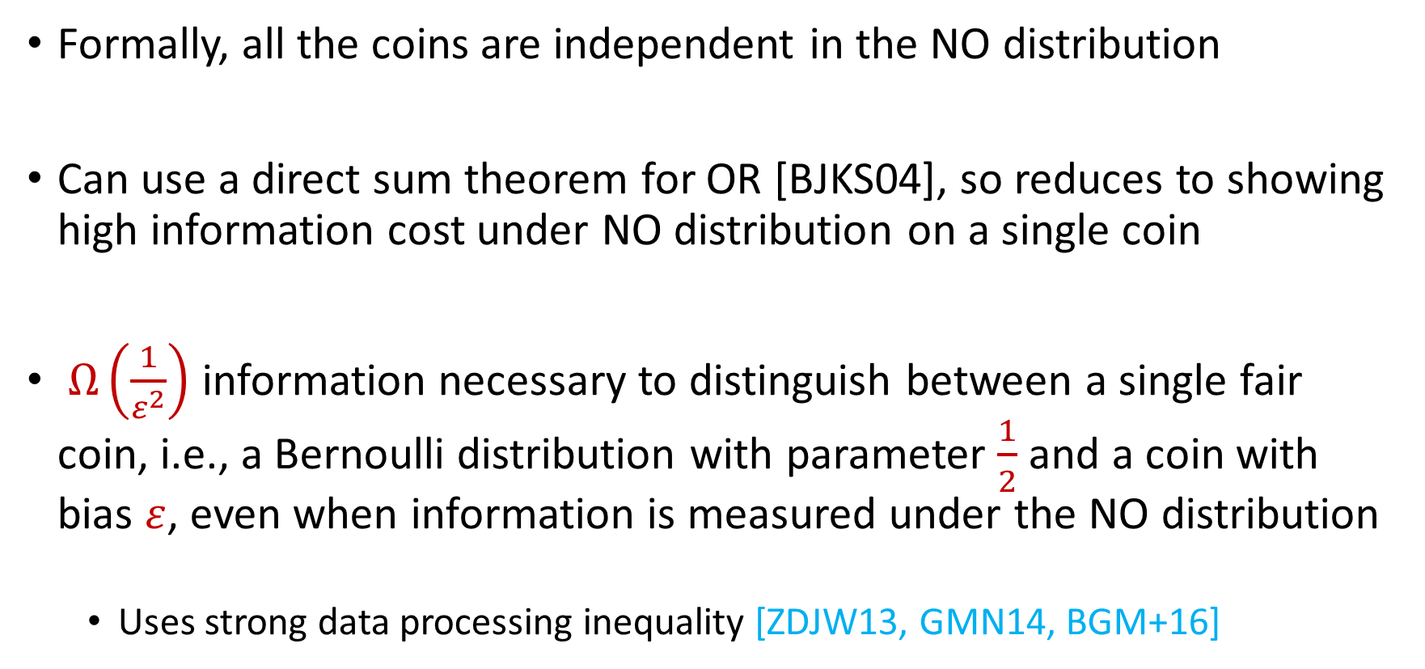
$ε$-DIFFDIST Problem
Formally, all the coins are independent in the NO distribution
Can use a direct sum theorem for OR [BJKS04], so reduces to showing high information cost under NO distribution on a single coin
$Ω\left(\frac{1}{ε^{2}}\right)$ information necessary to distinguish between a single fair coin, i.e., a Bernoulli distribution with parameter $\frac{1}{2}$ and a coin with bias $ε$, even when information is measured under the NO distribution
Uses strong data processing inequality [ZDJW13, GMN14, BGM+16]

Slide 39
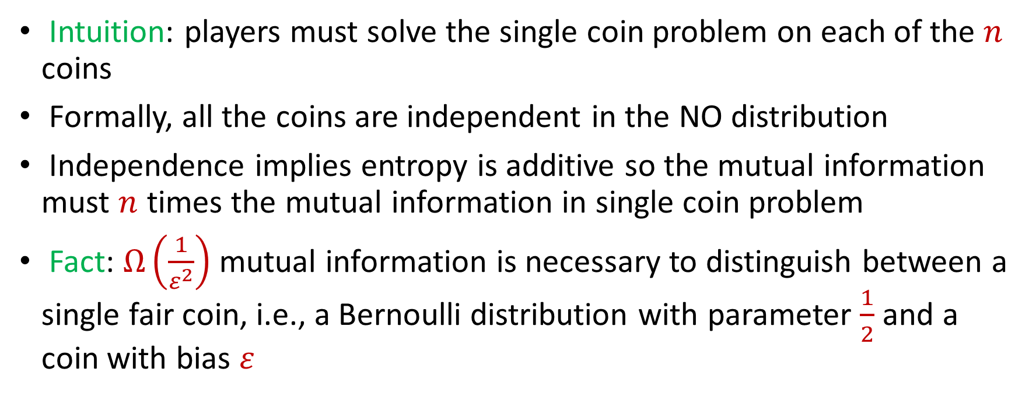
$ε$-DIFFDIST Problem
Intuition: players must solve the single coin problem on each of the $n$ coins
Formally, all the coins are independent in the NO distribution
Independence implies entropy is additive so the mutual information must $n$ times the mutual information in single coin problem
Fact: $Ω\left(\frac{1}{ε^{2}}\right)$ mutual information is necessary to distinguish between a single fair coin, i.e., a Bernoulli distribution with parameter $\frac{1}{2}$ and a coin with bias $ε$

Slide 40
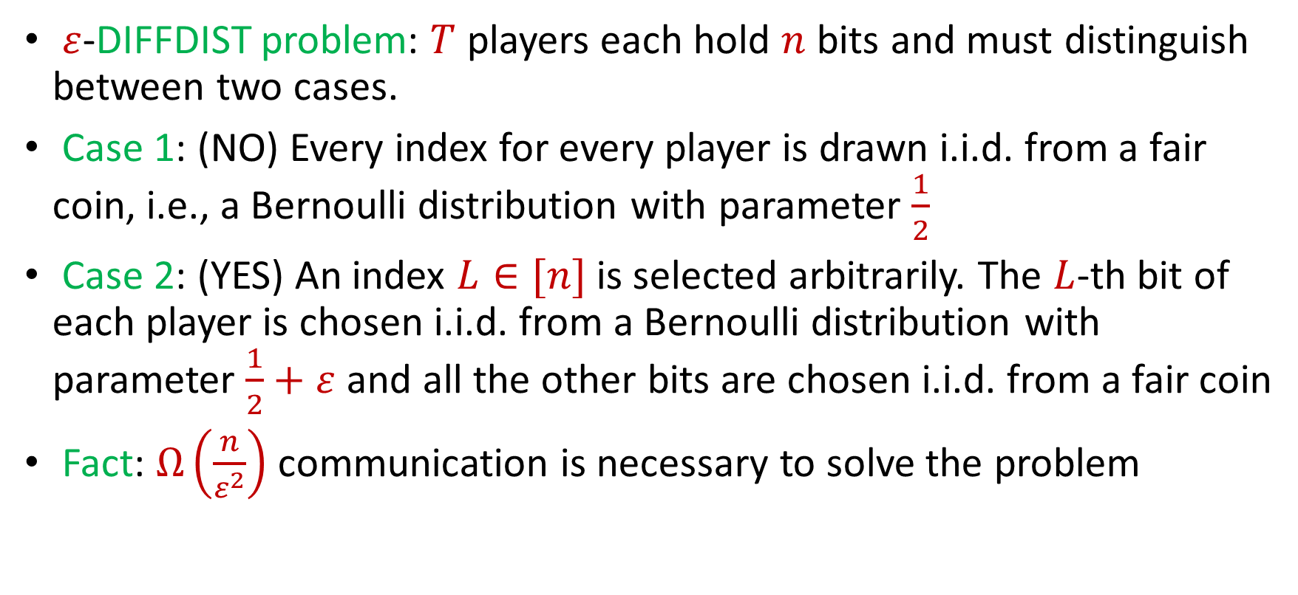
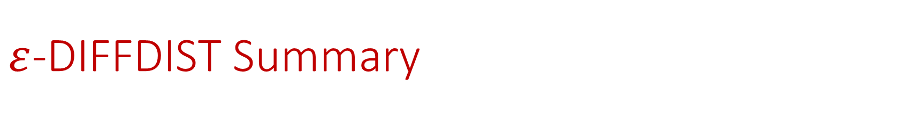
$ε$-DIFFDIST Summary
$ε$-DIFFDIST problem: $T$ players each hold $n$ bits and must distinguish between two cases.
Case 1: (NO) Every index for every player is drawn i.i.d. from a fair coin, i.e., a Bernoulli distribution with parameter $\frac{1}{2}$
Case 2: (YES) An index $L∈[n]$ is selected arbitrarily. The $L$-th bit of each player is chosen i.i.d. from a Bernoulli distribution with parameter $\frac{1}{2}+ε$ and all the other bits are chosen i.i.d. from a fair coin
Fact: $Ω\left(\frac{n}{ε^{2}}\right)$ communication is necessary to solve the problem

Slide 41
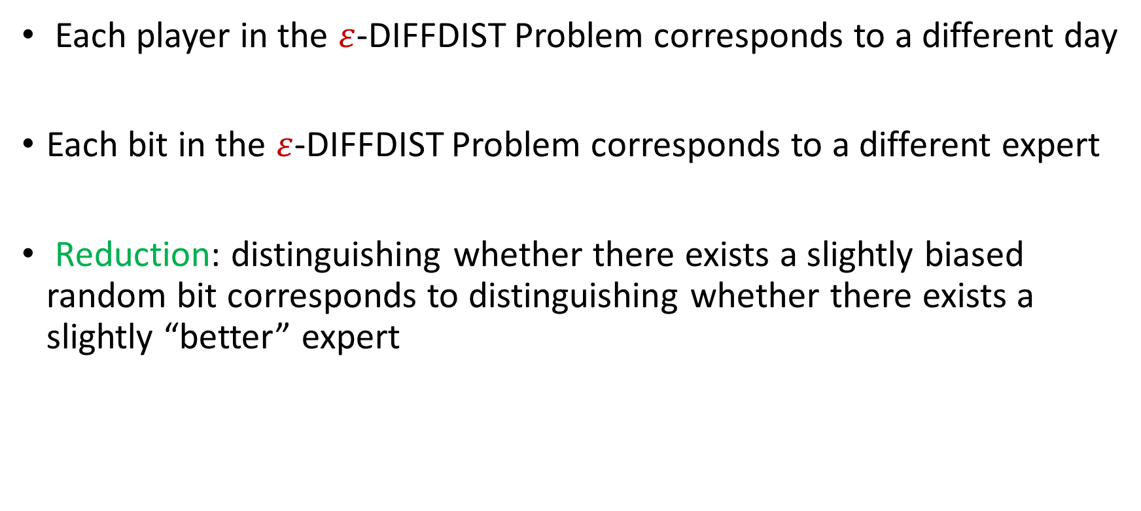
Reduction Intuition
Each player in the $ε$-DIFFDIST Problem corresponds to a different day
Each bit in the $ε$-DIFFDIST Problem corresponds to a different expert
Reduction: distinguishing whether there exists a slightly biased random bit corresponds to distinguishing whether there exists a slightly “better” expert

Slide 42
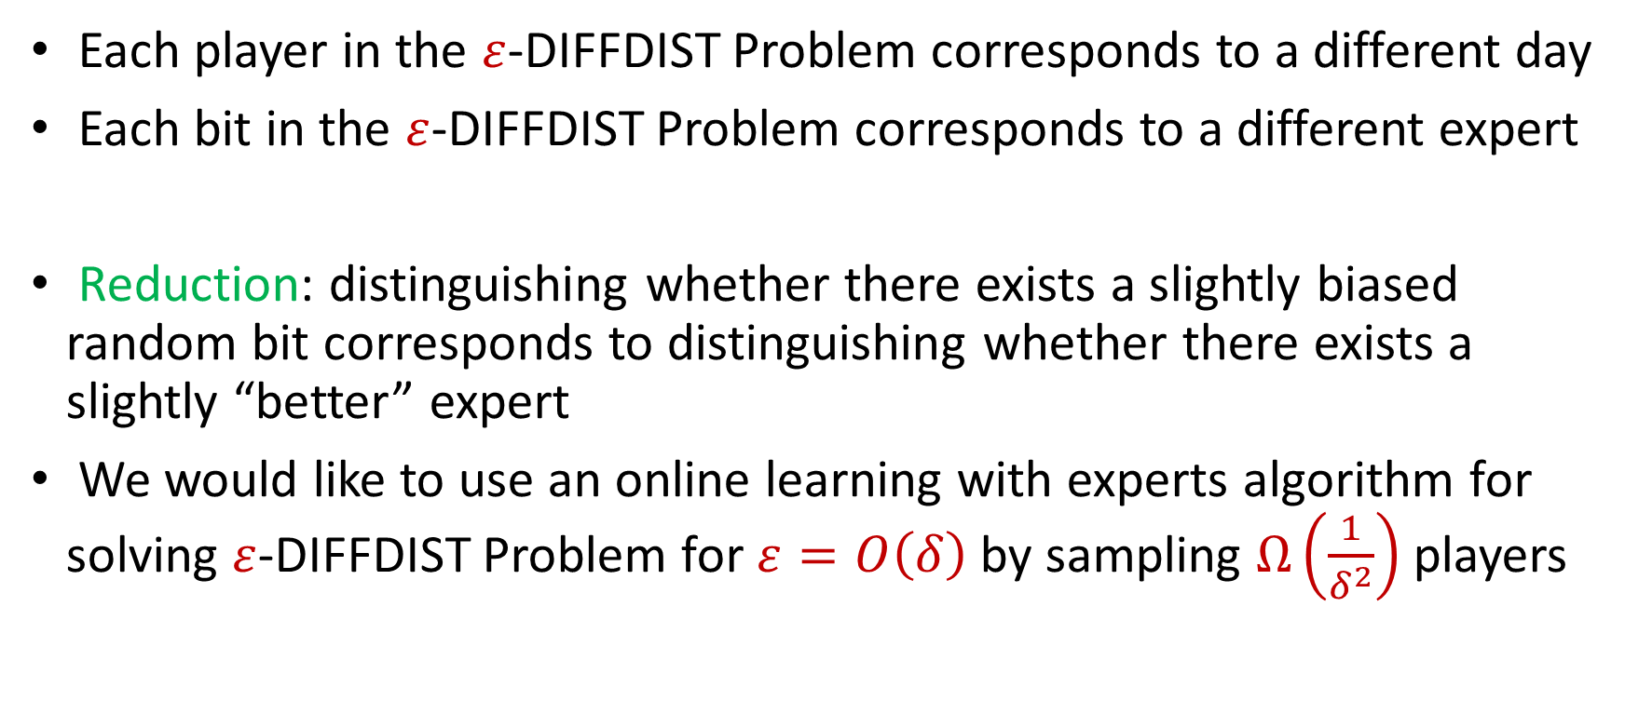
Reduction Intuition
Each player in the $ε$-DIFFDIST Problem corresponds to a different day
Each bit in the $ε$-DIFFDIST Problem corresponds to a different expert
Reduction: distinguishing whether there exists a slightly biased random bit corresponds to distinguishing whether there exists a slightly “better” expert
We would like to use an online learning with experts algorithm for solving $ε$-DIFFDIST Problem for $ε=O\left(δ\right)$ by sampling $Ω\left(\frac{1}{δ^{2}}\right)$ players

Slide 43
Reduction Challenge
Day
You
Actual outcome
1
2
3
4

Slide 44
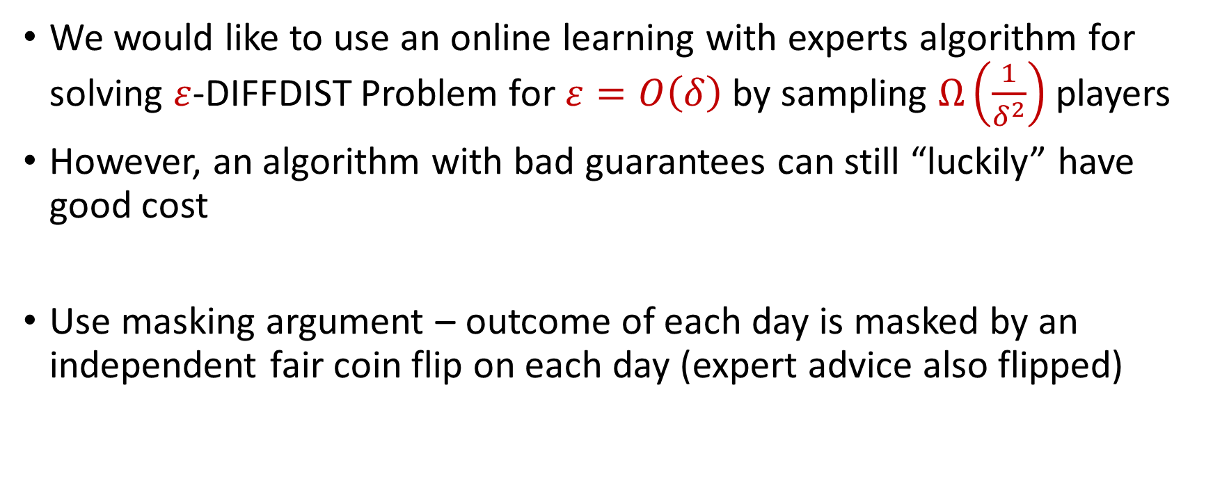
Reduction
We would like to use an online learning with experts algorithm for solving $ε$-DIFFDIST Problem for $ε=O\left(δ\right)$ by sampling $Ω\left(\frac{1}{δ^{2}}\right)$ players
However, an algorithm with bad guarantees can still “luckily” have good cost
Use masking argument – outcome of each day is masked by an independent fair coin flip on each day (expert advice also flipped)

Slide 45
Reduction Challenge
Day
Actual outcome
You
Actual outcome
1
MASK=1
2
MASK=0
3
MASK=1
4
MASK=1

Slide 46

Reduction
For constant $δ<\frac{1}{2}$, if there is no biased coin, no expert will do better than $\frac{1}{2}+\frac{δ}{3}$ with probability at least $\frac{1}{4}$
For constant $δ<\frac{1}{2}$, if there is a biased coin, an expert will do better than $\frac{1}{2}+\frac{2δ}{3}$ with probability at least $\frac{1}{4}$

Slide 47

Reduction Summary
The online learning with experts algorithm with regret $δ$ will be able to solve the $ε$-DIFFDIST Problem with probability at least $\frac{3}{4}$ for $ε=O\left(δ\right).$ Must use $Ω\left(\frac{n}{δ^{2}}\right)$ total communication
Any algorithm that achieves $δ<\frac{1}{2}$ regret with probability at least $\frac{3}{4}$ must use $Ω\left(\frac{n}{δ^{2}T}\right)$ space

Slide 48
Questions?
Format
Part 1: Background
Part 2: Lower Bound
Part 3: Arbitrary Model
Part 4: Random-Order Model

Slide 49

No Mistake Regime
For $M<\frac{δ^{2}T}{1280\log^{2}n }$ and $δ>\sqrt{\frac{128\log^{2}{n}}{T}}$, there exists an algorithm that uses $\tilde{O}\left(\frac{n}{δT}\right)$ space and achieves regret $δ$ with probability $\frac{4}{5}$
We know there is a really accurate expert. What if we iteratively pick “pools” of experts and delete them if they run “poorly”?

Slide 50
Reduction Problem
Day
You
Actual outcome
1
2
3
4

Slide 51

No Mistake Regime
If iteratively pick pool of next $k$ experts (“rounds”) and output the majority vote of the pool while deleting any incorrect expert, each pool will have at most $O(\log{k)}$ errors
If best expert makes no mistakes, use $\frac{n}{k}$ pools to achieve regret $δT$ means setting $k=\tilde{O}\left(\frac{n}{δT}\right)$

Slide 52

No Mistake Regime Summary
Algorithm: Iteratively pick pool of next $k=\tilde{O}\left(\frac{n}{δT}\right)$ experts (“rounds”) and output the majority vote of the pool while deleting any incorrect expert
If the number of rounds is small, the pools must have done well so the overall regret is small
The number of rounds cannot be large because at some point the best expert would have been sampled and retained

Slide 53

“Low-Mistake” Regime
Algorithm: Iteratively pick pool of next $k=\tilde{O}\left(\frac{n}{δT}\right)$ experts (“rounds”) and output the majority vote of the pool while deleting any incorrect expert
If best expert makes $M$ mistakes, use $\frac{nM}{k}$ pools to achieve regret $δT$ means setting $k=\tilde{O}\left(\frac{nM}{δT}\right)$, but this is too large!

Slide 54

“Low-Mistake” Fix-Its
Fix #1: Randomly sample pools of experts instead of iteratively picking pools
Problem #1: Cannot guarantee that the best expert will be retained
Fix #2: Delete experts that have erred with fraction at least $1−δ$
Problem #2: “Build-up” of errors

Slide 55



A Really Bad Case Study
Suppose $δ=\frac{1}{2}$
Example shows that the pool of $k=8$ sampled experts can make roughly $T−T/k$ errors

Slide 56

“Low-Mistake” Regime
Algorithm: Repeatedly sample a pool of $k=\tilde{O}\left(\frac{n}{δT}\right)$ experts and output the majority vote of the pool while deleting any expert with lower than $1−\frac{δ}{8\log{n}}$ accuracy since it was sampled
If the number of rounds is small, the pools must have done well so the overall regret is small
The number of rounds cannot be large because at some point the best expert would have been sampled and retained
WANT TO SHOW

Slide 57

“Low-Mistake” Regime: First Property
Algorithm: Repeatedly sample a pool of $k=\tilde{O}\left(\frac{n}{δT}\right)$ experts and output the majority vote of the pool while deleting any expert with lower than $1−\frac{δ}{8\log{n}}$ accuracy since it was sampled
Lemma: For $δ>\sqrt{\frac{128\log^{2}{n}}{T}}$, a pool that is used for $t$ days can only make $\frac{tδ}{2}+4\log{n}$ mistakes
For the algorithm to make $Tδ$ mistakes, need at least $\frac{Tδ}{8\log{n}}$ rounds

Slide 58

“Low-Mistake” Regime: Second Property
For the algorithm to make $Tδ$ mistakes, need at least $\frac{Tδ}{8\log{n}}$ rounds
“$BAD$” day: the best expert is deleted by the pool if it is sampled on that day
$\left|BAD\right|≤\frac{8Mlog n}{δ}$
X
X
X
X
X
X

Slide 59






“Low-Mistake” Regime: Second Property
For the algorithm to make $Tδ$ mistakes, need at least $\frac{Tδ}{8\log{n}}$ rounds
A bad algorithm must not sample the best expert on a “$GOOD$” day
“$BAD$”
“$BAD$”
“$BAD$”
“$GOOD$”

Slide 60

“Low-Mistake” Regime: Second Property
For the algorithm to make $Tδ$ mistakes, need at least $\frac{Tδ}{8\log{n}}$ rounds
Must avoid sampling the best expert on $Ω$ $\left(\frac{Tδ}{\log{n}}\right)$ rounds
$O$ $\left(\frac{n\log^{2}{n}}{δT}\right)$ experts sampled in each round → low probability

Slide 61









Analysis
Define a set of random variables $d_{1},d_{2},…$ for each round’s day
Given $d_{i}$, draw $d_{i+1}$ from the distribution of possible days for the next round based on possible experts sampled in the pool conditioned on entire history
$$d_{1}$$
$$d_{2}$$
$$d_{3}$$
$$d_{4}$$
“$BAD$”
“$BAD$”
“$BAD$”
“$GOOD$”

Slide 62




Idealized Analysis
Analysis: conditioned on the number of rounds being small, the algorithm makes a small number of mistakes
Subtle pitfall: if the best expert is sampled on a good day, then there will be no more rounds, so the conditional probability analysis is difficult
$$d_{1}$$
$$d_{2}$$
$$d_{3}$$
$$d_{4}$$
“$GOOD$”
“$GOOD$”
“$GOOD$”
“$GOOD$”

Slide 63

Simple Decoupling Argument
Instead of conditioning on total number of rounds, consider a decoupling argument, where we draw the day of the next round over a matching distribution
Define a set of random variables $d_{1},d_{2},…$ for each round’s day
Given $d_{i}$, draw $d_{i+1}$ from the distribution of possible days for the next round based on possible experts sampled in the pool conditioned on entire history
Results in a Poisson process, then apply same analysis bounding the number of resamplings on “$GOOD$” days

Slide 64

Arbitrary Order Model Summary
Algorithm: Repeatedly sample a pool of $k=\tilde{O}\left(\frac{n}{δT}\right)$ experts and output the majority vote of the pool while deleting any expert with lower than $1−\frac{δ}{8\log{n}}$ accuracy since it was sampled
If the number of rounds is small, the pools must have done well so the overall regret is small
The number of rounds cannot be large because at some point the best expert would have been sampled and retained

Slide 65
Questions?
Format
Part 1: Background
Part 2: Lower Bound
Part 3: Arbitrary Model
Part 4: Random-Order Model

Slide 66

Random-Order Streams
There exists an algorithm that uses $O\left(\frac{n}{δ^{2}T}\log^{2}{n}\log{\frac{1}{δ}}\right)$ space achieves expected regret $δ>\sqrt{\frac{8\log{n}}{T}}$ in the random-order model
We used majority vote of remaining experts in sampled pool
Instead of removing experts, could just downweight them and run deterministic weighted majority
Why not randomized weighted majority, i.e., multiplicative weights?
TAKING A STEP BACK

Slide 67

Random-Order Streams
Algorithm: Repeatedly sample a pool of $k=\tilde{O}\left(\frac{n}{δ^{2}T}\right)$ experts and run multiplicative weights on pool, resample if the expected cost of the pool over $t$ time “is bad”.

Slide 68
Multiplicative Weights Algorithm

Slide 69
Weighted Majority (Littlestone, Warmuth 89)
Day
Algorithm
Actual outcome
weights
1
1
1
1
1
1
1/2
1
1
2
1
1/2
1/2
1
3
Algorithm makes 2 mistakes
1/2
1/2
1/4
1/2
Best expert makes 1 mistake
4
1/2
1/4
1/4
1/4

Slide 70

Multiplicative Weights Algorithm
Theorem (Arora, Hazan, Kale 2012): Expected number of mistakes by the algorithm is at most $\frac{ln n}{ε}+\left(1+ε\right)M$

Slide 71

Random-Order Streams
Algorithm: Repeatedly sample a pool of $k=\tilde{O}\left(\frac{n}{δ^{2}T}\right)$ experts and run multiplicative weights on pool, resample if the expected cost of the pool over $t$ time “is bad”
Can compute this expected cost, so if it doesn’t follow the theory, it means you didn’t sample the best expert

Slide 72

Random-Order Streams
Algorithm: Repeatedly sample a pool of $k=\tilde{O}\left(\frac{n}{δ^{2}T}\right)$ experts and run multiplicative weights on pool, resample if the expected cost of the pool over $t$ time “is bad”.
If the number of rounds is small, the pools must have done well so the overall regret is small
The number of rounds cannot be large because at some point the best expert would have been sampled and retained
WANT TO SHOW

Slide 73




Random-Order Idea
Enforce
(1) the algorithm will do well when the pool contains the best expert
(2) we will never delete the pool if it contains the best expert
The number of rounds cannot be large because at some point the best expert would have been sampled and retained
“$GOOD$”
“$GOOD$”
“$GOOD$”
“$GOOD$”

Slide 74

Summary of Multiplicative Weights Algorithm
There exists an algorithm that uses $O\left(\frac{n}{δ^{2}T}\log^{2}{n}\right)$ space and achieves regret$δ>\sqrt{\frac{16\log^{2}{n}}{T}}$ in the random-order model (assuming the number of mistakes $M$ made by the best expert is known)
Remove the assumption that $M$ is known by using random-order property plus prefix of the stream to estimate $M$

Slide 75

Summary of Multiplicative Weights Algorithm
There exists an algorithm that uses $O\left(\frac{n}{δ^{2}T}\log^{2}{n}\right)$ space achieves expected regret$δ>\sqrt{\frac{16\log^{2}{n}}{T}}\text{,} δ>\frac{M}{T}$ in the random-order model (assuming the number of mistakes $M$ made by the best expert is known)
Remove the assumption that $M$ is known?

Slide 76


Removing the Assumption on $M$
Do a binary search for $\frac{M}{T}$ with $γ$ as the running estimate
Proceed through $ℓ=2\log{\frac{1}{δ}}$ epochs, each of length $\frac{δT}{ℓ}$
Run previous algorithm on with estimated cost $γ⋅\frac{δT}{ℓ}$ and target regret $O\left(1\right)$ until we have a $(1+O\left(δ\right))$-approximation of $\frac{M}{T}$ by $γ$
Since regret is lower, space usage increases by a factor of $O\left(ℓ\right)$ for $δ≤\frac{M}{T}$

Slide 77

Summary of Random-Order Model
Given $δ>\sqrt{\frac{16\log^{2}{n}}{T}}$ , there exists an algorithm in the random-order model that uses achieves expected regret $δ$ and uses $O\left(\frac{n}{δ^{2}T}\log^{2}{n}\right)$ space
Generalizes to other sequential prediction algorithms!

Slide 78

Subsequent Results
[PZ23] gave an algorithm with regret $O_{n}\left(T^{\frac{2}{2+δ}}\right)$ and space $O(n^{δ})$, e.g., regret $O_{n}\left(T^{\frac{4}{5}}\right)$ and space $O(\sqrt{n})$, or regret $O_{n}\left(T^{0.67}\right)$ and space $O\left(n^{0.99}\right)$
[PZ23] also achieved regret $o(T)$ with space $polylog\left(n\right)$
[PR23] gave an algorithm that uses space $S$ and obtains regret $\tilde{O}\left(\sqrt{\frac{nT}{S}}\right)$

Slide 79

Summary of Results
Any algorithm that achieves $δ<\frac{1}{2+√32\ln{8}}$ regret with probability at least $\frac{3}{4}$ must use $Ω\left(\frac{n}{δ^{2}T}\right)$ space
There exists an algorithm that uses $O\left(\frac{n}{δ^{2}T}\log^{2}{n}\right)$ space and achieves expected regret $δ>\sqrt{\frac{16\log^{2}{n}}{T}}$in the random-order model
For $M<\frac{δ^{2}T}{1280\log^{2}n }$ and $δ>\sqrt{\frac{128\log^{2}{n}}{T}}$, there exists an algorithm that uses $\tilde{O}\left(\frac{n}{δT}\right)$ space and achieves regret $δ$ with probability $\frac{4}{5}$

Slide 80


Summary of Results II
If the cost is between $\left[0,ρ\right]$, the expected regret is $ρδ$ for both models
General regret in random-order model (multiplicative weights) → use same algorithm
General regret in arbitrary-order model (weighted majority) → output random expert

Slide 81

Summary of Results
Any algorithm that achieves $δ<\frac{1}{2}$ regret with probability at least $\frac{3}{4}$ must use $Ω\left(\frac{n}{δ^{2}T}\right)$ space
There exists an algorithm that uses $O\left(\frac{n}{δ^{2}T}\log^{2}{n}\right)$ space in the random-order model
For $M<\frac{δ^{2}T}{1280\log^{2}n }$ , there exists an algorithm that uses $\tilde{O}\left(\frac{n}{δT}\right)$ space and
achieves regret $δ$
If the cost is between $\left[0,ρ\right]$, the regret is $ρδ$ for both models
Questions: tight bounds for arbitrary order streams?
how general is this framework beyond the experts problem?

Slide 82

Future Work?
What bounds for arbitrary-order streams can be shown when the best expert incurs unrestricted cost? For constant $δ$, can we tolerate a constant fraction of mistakes?
Extra constraints are imposed on the experts, i.e., side information

Slide 83

Future Work?
What bounds for arbitrary-order streams can be shown when the best expert incurs unrestricted cost? For constant $δ$, can we tolerate a constant fraction of mistakes?
What happens when predictions are real values and evaluated against the correct answer with respect to a loss function?
Extra constraints are imposed on the experts, i.e., side information

Slide 84

Follow the Perturbed Leader
Theorem (Kalai and Vempala 2005): Expected number of mistakes by the algorithm is at most $\frac{O(ln n)}{ε}+\left(1+ε\right)M$

Slide 85

Multiplicative Weights Algorithm
Theorem (Arora, Hazan, Kale 2012): Expected cost of the algorithm is $\sum_{t=1}^{T}{\sum_{i=1}^{n}{c_{i}^{(t)}p_{i}^{(t)}}}≤\frac{ln n}{ε}+(1+ε)\sum_{t=1}^{T}{c_{i}^{(t)}}$ for each $i∈[n]$ (and in particular the best expert), i.e, $≤\frac{ln n}{ε}+\left(1+ε\right)M$
$ε$ is trade-off term between multiplicative and additive error

Slide 86

Follow the Perturbed Leader
Theorem (Kalai and Vempala 2005): Expected cost of the algorithm is $\frac{O(ln n)}{ε}+(1+ε)\sum_{t=1}^{T}{c_{i}^{(t)}}$ for each $i∈[n]$ (and in particular the best expert), i.e, $≤\frac{O(ln n)}{ε}+\left(1+ε\right)M$
$ε$ is trade-off term between multiplicative and additive error

Slide 87
Follow the Perturbed Leader

Slide 88

Random-Order Streams: First Property
Structural lemma: Let $X_{1},…,X_{t}$ be independent random variables in $[0,1]$ with expectation $α$ and $X$ be their sum. Then $Pr\left[\left|X−αt\right|≥4\sqrt{t\log{T}}\right]≤\frac{1}{T^{2}}$
By the guarantee for multiplicative weights for $ε=\frac{δ}{2}$, the cost of each pool is at most $\left(1+\frac{δ}{2}\right)\left(αt+4\sqrt{t\log{T}}\right)+\frac{2\ln{n}}{δ}$
For $δ>\sqrt{\frac{16\log^{2}{n}}{T}}$, $δ>\frac{M}{T}$, number of rounds must be at least $Ω\left(\frac{δ^{2}T}{\log{n}}\right)$

Slide 89

Random-Order Streams: Second Property
Number of rounds must be at least $Ω\left(\frac{δ^{2}T}{\log{n}}\right)$
Must avoid sampling the best expert on at least $Ω\left(\frac{δ^{2}T}{\log{n}}\right)$ rounds
$O$ $\left(\frac{n\log^{2}{n}}{δ^{2}T}\right)$ experts sampled in each round → low probability
Must use same “decoupling” argument
Similar analysis for $δ≤\frac{M}{T}$

Slide 90

“Low-Mistake” Regime: Second Property
For the algorithm to make $Tδ$ mistakes, need at least $\frac{Tδ}{8\log{n}}$ rounds
“$BAD$” day: the best expert is deleted by the pool if it is sampled on that day
$\left|BAD\right|≤\frac{8Mlog n}{δ}$ and $M<\frac{δ^{2}T}{1280\log^{2}n }$ , so the remaining rounds must be sampled on “$GOOD$” days and avoid the best expert
Must avoid sampling the best expert on at least $\frac{Tδ}{16\log{n}}$ rounds
$O$ $\left(\frac{n\log^{2}{n}}{δT}\right)$ experts sampled in each round → low probability

Slide 91

Guarantee for Weighted Majority
Theorem (Deterministic Weighted Majority)
where M is the # of mistakes the best expert makes, n is # of experts.
# of mistakes by deterministic weighted majority
≤ 2.41 (M + log₂ n)
${\left(\frac{1}{2}\right)}^{M}≤$ sum of the weights $≤{\left(\frac{3}{4}\right)}^{m}n$
$m≤\frac{M+\log_{2}{n}}{\log_{2}{ \frac{4}{3}}}$

